Slide 1
Capstone Project-2
Supervised ML on Seoul Bike Sharing Dataset (Regression)
- Soma Pavan Kumar(Pro Flex) - spkumar1998@gmail.com

Slide 2
Contents
1. Problem Statement
2. Introduction
3. Data Cleaning and Data Viz
4. Data Modelling and implementation
5. Conclusion

Slide 3
Problem Statement
Currently Rental bikes are introduced in many urban cities for the enhancement of mobility comfort. It is important to make the rental bike available and accessible to the public at the right time as it lessens the waiting time.
Eventually, providing the city with a stable supply of rental bikes becomes a major concern. The crucial part is the prediction of bike count required at each hour for the stable supply of rental bikes.

Slide 4
Introduction
Bike sharing systems are a means of renting bicycles where the process of obtaining membership, rental, and bike return is automated via a network of kiosk locations throughout a city.
Using these systems, people are able rent a bike from a one location and return it to a different place on an as-needed basis. Currently, there are over 500 bike-sharing programs around the world.

Slide 5
Variable Information
8. Dew point temperature - Celsius 9. Solar radiation - MJ/m2 10. Rainfall - mm 11. Snowfall - cm 12. Seasons - Winter, Spring, Summer, Autumn 13. Holiday - Holiday/No holiday 14. Functional Day – No Func(Non Functional Hours), Fun(Functional hours)
1. Date : year-month-day 2. Rented Bike count - Count of bikes rented at each hour 3. Hour - Hour of he day 4. Temperature-Temperature in Celsius 5. Humidity - % 6. Windspeed - m/s 7. Visibility - 10m

Slide 6
Data Wrangling
Data wrangling is the process of cleaning and unifying messy and complex data sets for easy access and analysis.
Our Dataset includes about 14 columns and about 8760 observations
We observed a huge correlation between the variables Temperature and Dew point Temperature. So, we had to drop the column Dew point variable so it doesn’t introduce bias in our predictions.

Slide 7
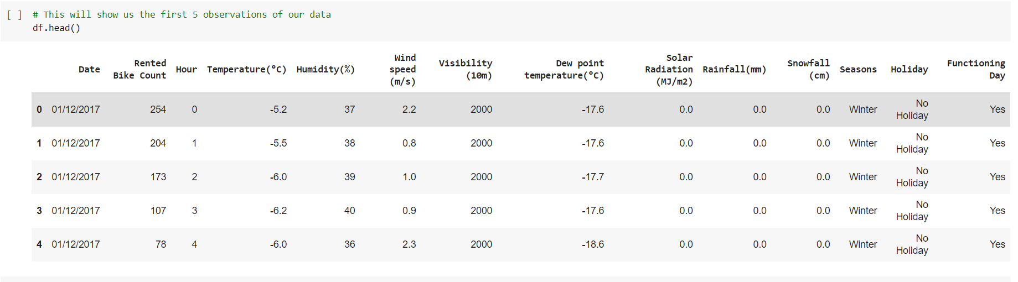
After cleaning the snippet of data looks like:
The df.head() method shows us the first 5 rows of the Dataset.

Slide 8
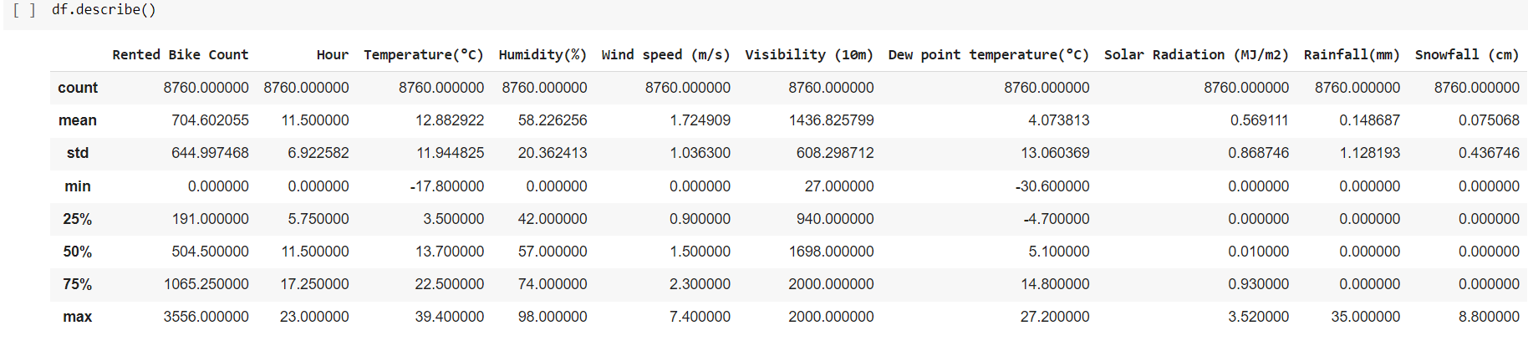
Let us look at some statistics of the Data
The Statistics of the data could be found out from an inbuilt function in pandas library called describe() .

Slide 9
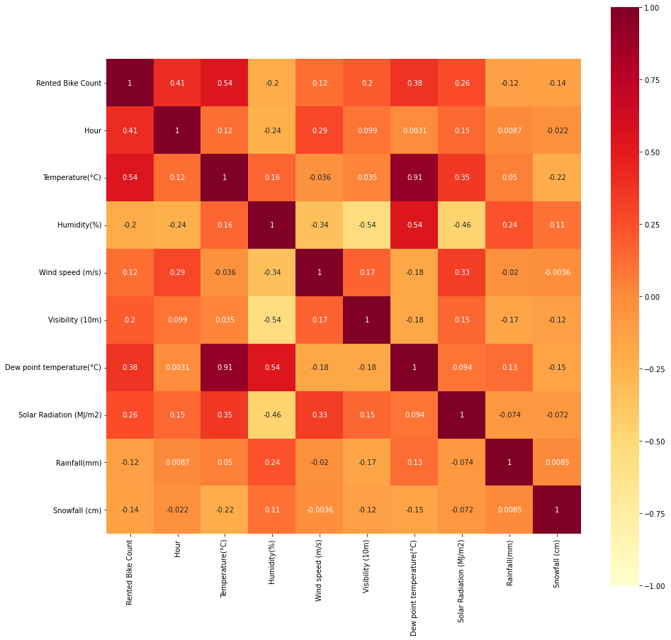
Lets begin with visualizations
\1. Lets plot the Correlations between the independent variables/features in the dataset.
We find out that there is very high correlation between the Variables between Temperature and Dew point Temperature.
Also, there is significant correlation between Rented bike count and Temperature.
And also there is a significant correlation between Dew point Temperature and Humidity

Slide 10
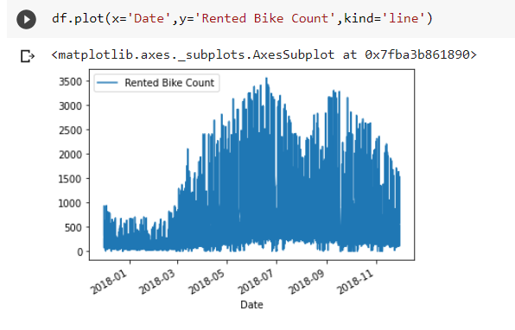
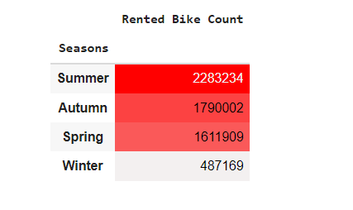
2. Plotting graph and a chart to find out the maximum number of riders according to the seasons:
The Graphs and the chart show that most number of bikes are ridden in Summer and consequently in autumn.

Slide 11
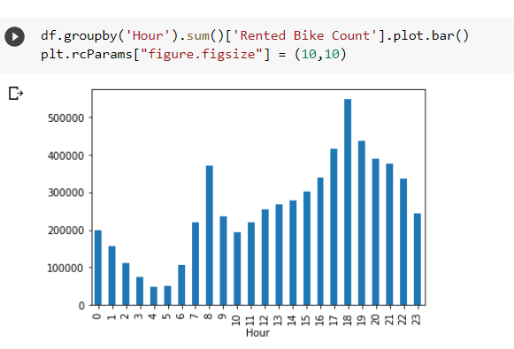
3. Plotting the frequency of number of rides according to the hour of the day
By plotting this graph, we see the less obvious that people use the rented bikes at 08:00 in the morning and 18:00 in the evening. Which are the most obvious times for a person to rent a bike while heading to their offices and back.

Slide 12
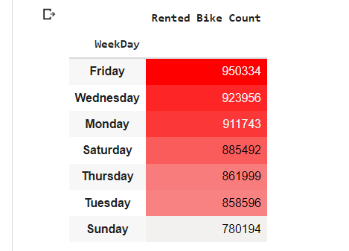
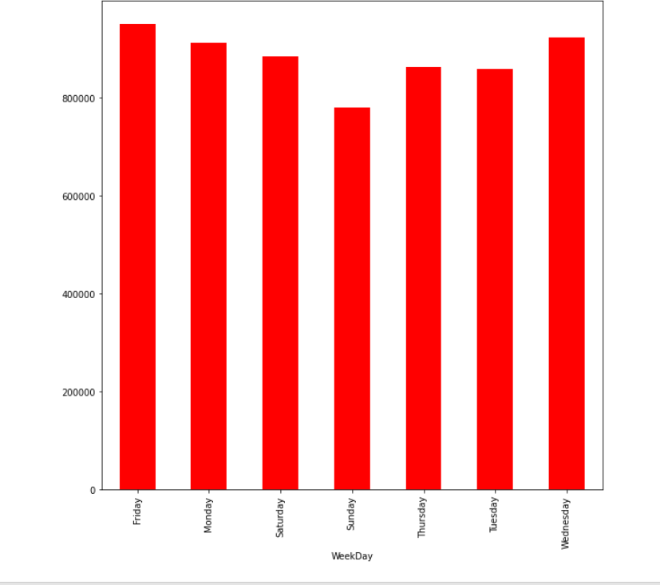
4. Plotting the frequency of number of rides taken according to day of the week.
To find out that Friday is the busiest in terms of the number of rented bike counts.

Slide 13
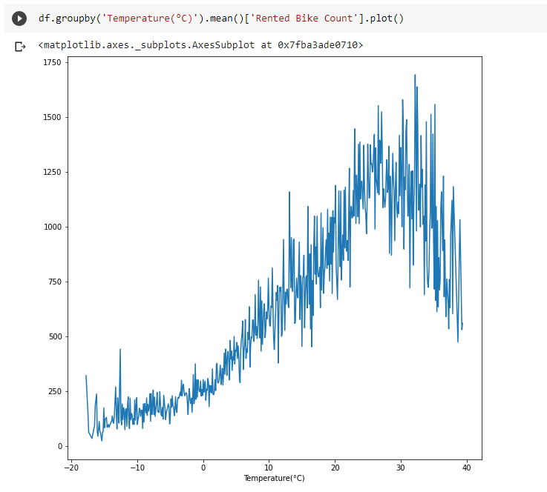
5. Plotting the Temperatures in which Koreans would like to ride their bikes
The sweet spot of temperature in which Korean people like to ride their bikes is around 25 degree Celsius to 30 degree Celsius which can get hot.

Slide 14
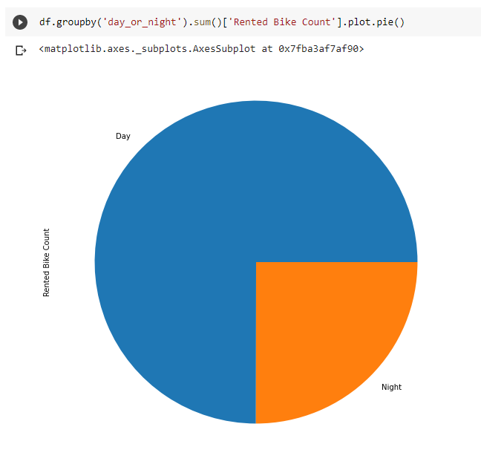
6. Plotting which part of the day (Day or Night) do the people of Korea like to ride their bikes:
So, we find out that as usual and sane, more than 75% of Korean people like to ride their bikes in the daylight for their commute to offices back and forth. And only a few people like to ride their bikes after 08:00 in the night.

Slide 15
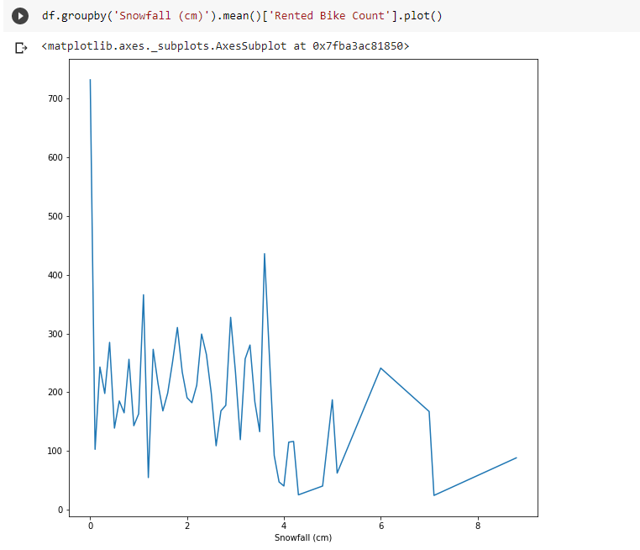
7. Plotting how many people ride in Snowfall and how much of snowfall.
People like to ride their rented bikes in Absolute no rainfall and there are people who like to ride their bikes in a little snowfall.

Slide 16
Data modelling
Data Modelling is the process of analyzing the data objects and their relationship to the other objects. It is used to analyze the data requirements that are required for the business processes.
Train test split
The procedure involves taking a dataset and dividing it into two subsets. The first subset is used to fit the model and is referred to as the training dataset. The second subset is not used to train the model; instead, the input element of the dataset is provided to the model, then predictions are made and compared to the expected values. This second dataset is referred to as the test dataset.

Slide 17
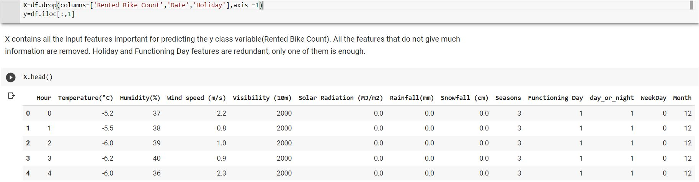
The Data is split into X and Y . Where X is all our independent Variables and Y is dependent variables(Rented Bike Count).
The first five observations of X is shown below

Slide 18
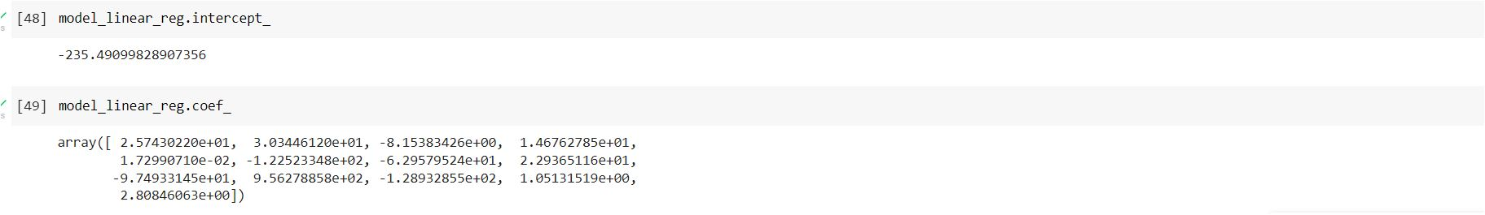
Lets implement Machine Learning Algorithms!
1. Multiple Linear Regression:
It is a statistical technique that uses several explanatory variables to predict the outcome of a response variable. Multiple regression is an extension of linear (OLS) regression that uses just one explanatory variable.
After implementation, the intercepts and coefficients of the model are given below.

Slide 19
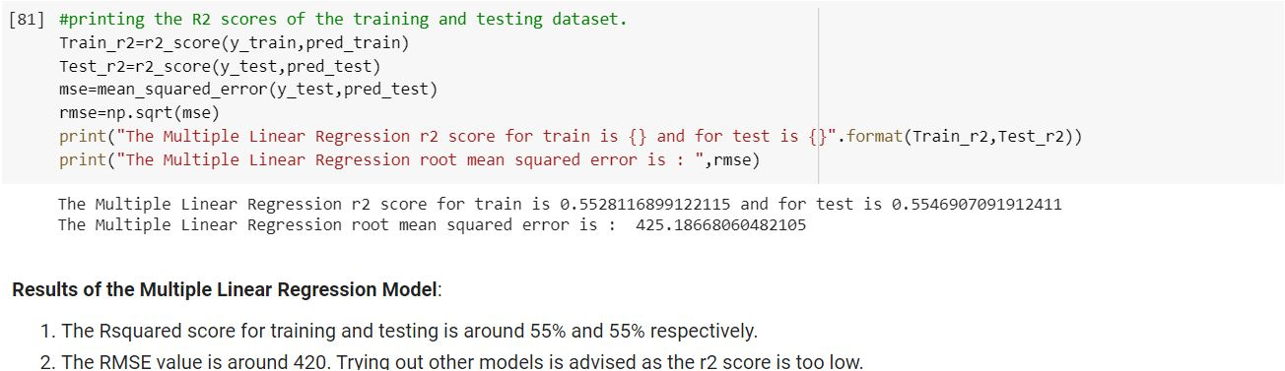
The R2 scores for Multiple Linear Regression for train dataset is around 55% and same goes for test dataset which is also around 55%. The RMSE value is around 420 as shown in the figure below:

Slide 20
2. Decision Tree Regressor
Decision tree builds regression or classification models in the form of a tree structure. It breaks down a dataset into smaller and smaller subsets while at the same time an associated decision tree is incrementally developed. The final result is a tree with decision nodes and leaf nodes.
The Decision tree regressor when fitted to our data gives us better results than linear regression model as it is more complex than our previous model.
Hence as expected, the accuracy scores and R2 scores are better than our previous model.

Slide 21
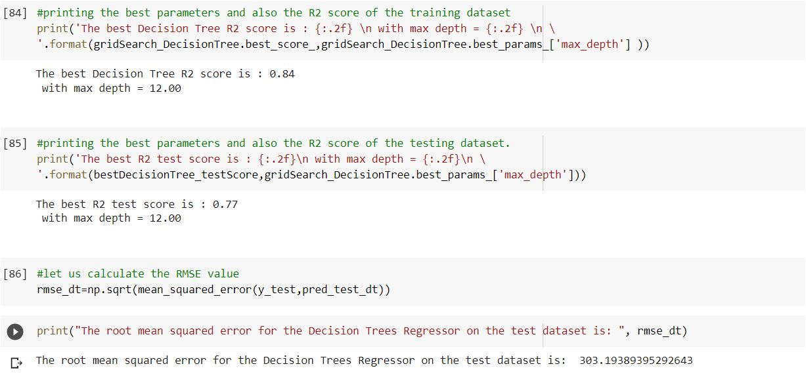
The R2 scores for Decision Tree Regressor algorithm is:
The R2 scores for train dataset is 0.84 or 84%with a max depth of 12.
And the Best R2 scores for test dataset is 0.77 or 77% with the same max_depth parameter. The RMSE value is around 300.

Slide 22
3. Random forest regressor
Random Forest Regression is a supervised learning algorithm that uses ensemble learning method for regression. Ensemble learning method is a technique that combines predictions from multiple machine learning algorithms to make a more accurate prediction than a single model.
The Random forest is a tad bit more complex than decision trees as it uses multiple Decision trees and hence it is expected to have more accuracy in this model.

Slide 23
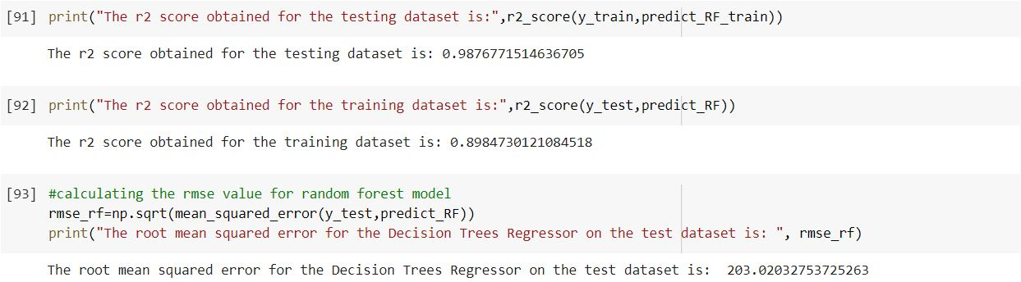
The R2 scores for Random Forest train dataset is 0.98 or 98%.
The R2 scores for Random Forest test dataset is 0.89 or 89%.
The RMSE value is around 200.

Slide 24
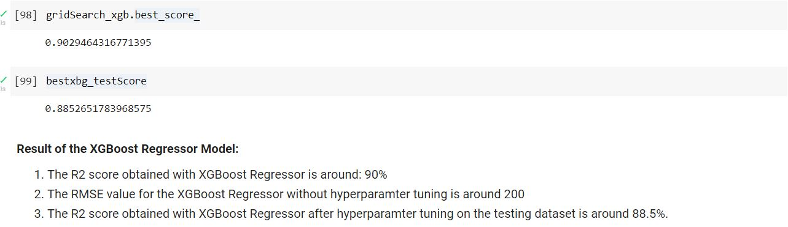
4. XGBoost regressor
XGBoost is an efficient implementation of the gradient boosting algorithm that can be used for regression predictive modelling. It is fast because of the capacity to do parallel computation on a single machine.It is one of the best Regression models that can be used. It is also used in finding important features of a dataframe.

Slide 25
The accuracy scores or R2 scores for XGBoost is very good, almost as good as Random Forest Regressor.
The Train dataset R2 score is 0.9 or 90% with estimators of 1000 and best learning rate is 0.1
The Test dataset scores R2 score is 0.885 or 88.5% with the same hyper parameters.
The RMSE value is around 200.

Slide 26
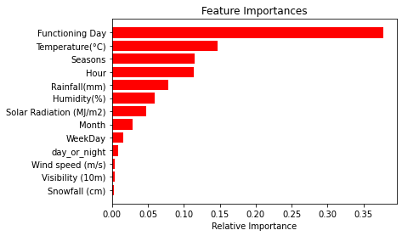
Feature Importances using XGBoost
The most important features are:
Functioning Day
Temperature
Seasons
Hence, these are the features that are the most important in determining the number of bikes rented that particular day.

Slide 27
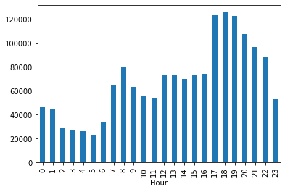
Results: Per Hour Demand as per the Random Forest Model
Hence, at 8 AM in the morning and from 5pm to 8 pm the demand in very high. The is slight rise in demand at 10pm. These are the timings at which the bikes should be available in good number in order to decrease the waiting time.
Here, the testing dataset is used as input to the XGBoost Regressor model and the results are plotted in the form of a graph.

Slide 28
Conclusion
The Dataset I choose to Explore is the data on Seoul Bike Sharing Dataset. Which includes the data which influences people renting a bicycle may it be Temperature, Humidity and so on.
The Parameter that does not affect the number bikes ridden is the week day or which day of the week. Regardless of which week day it is the number of rides taken remains more or less the same.

Slide 29
We also saw that people like to rent and ride their bikes in office hours that is 08:00 in the morning and 18:00 in the evening.
And People like to ride when there is the least rainfall and snowfall.
So, to predict we would like to use the Random Trees Regressor algorithm to make further predictions.
The Results were predicted and were plotted in the form of a graph to find out at hour of the day the demand is high, so that the availability of the bikes can be ensured in order to reduce the waiting time.

